Slide 1

UWEBIC IY425
Electrical and Electronic Engineering Principles 2
Capacitors: Exercises
Monday 24-Jan-2022

Slide 2
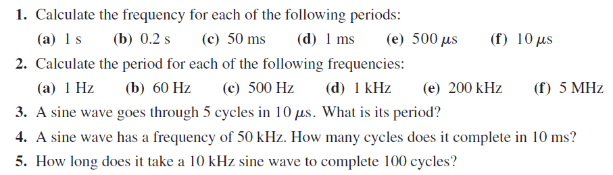
Exercises

Slide 3
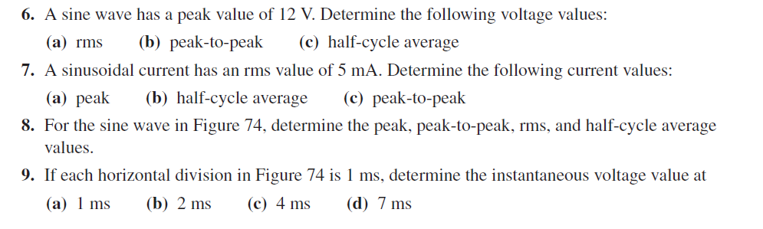
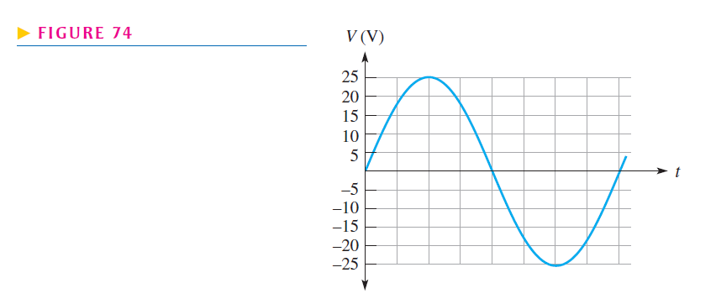
Exercises

Slide 4
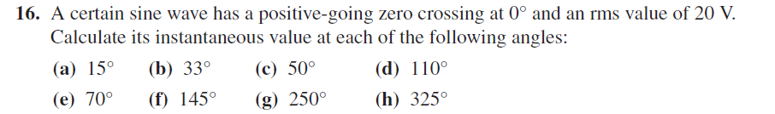
Exercises

Slide 5
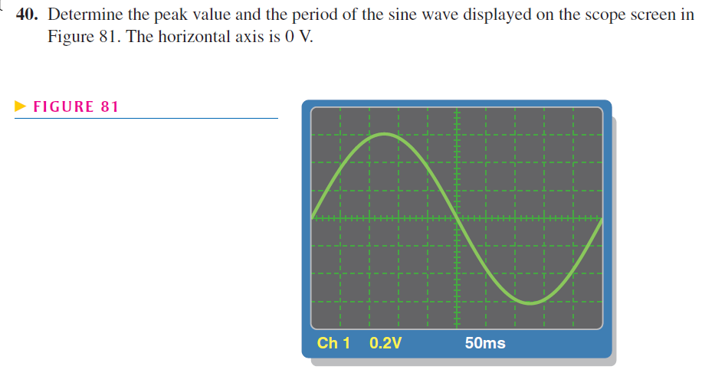
Exercises

Slide 6
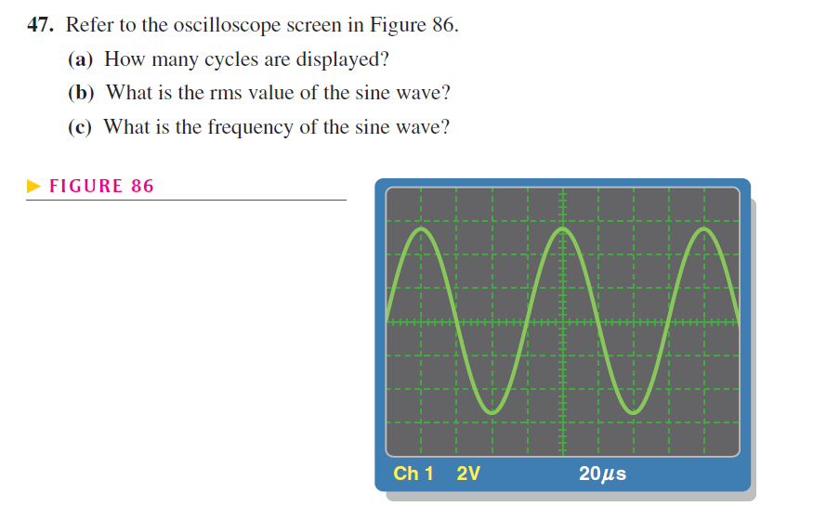
Exercises

Slide 7
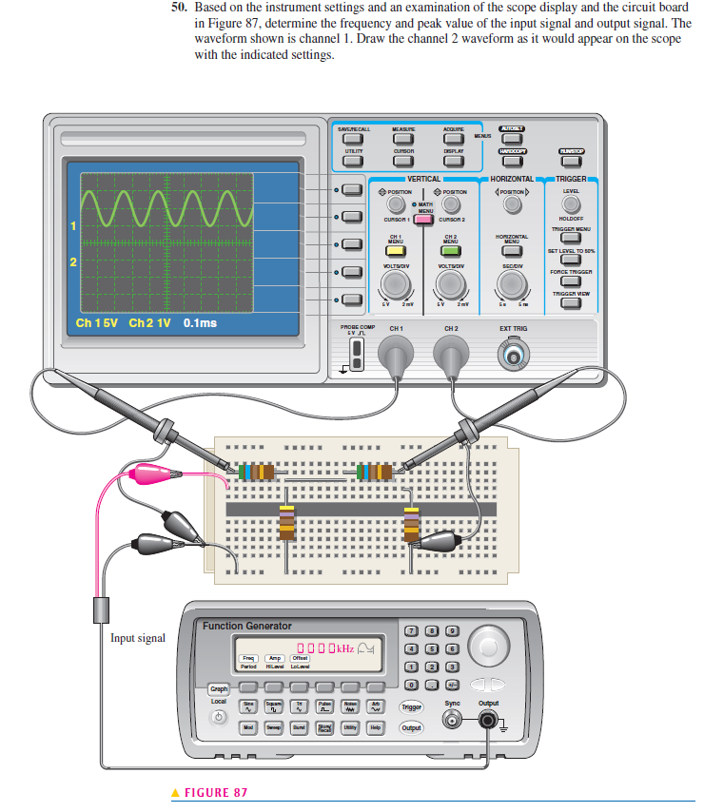
Exercises

Slide 8
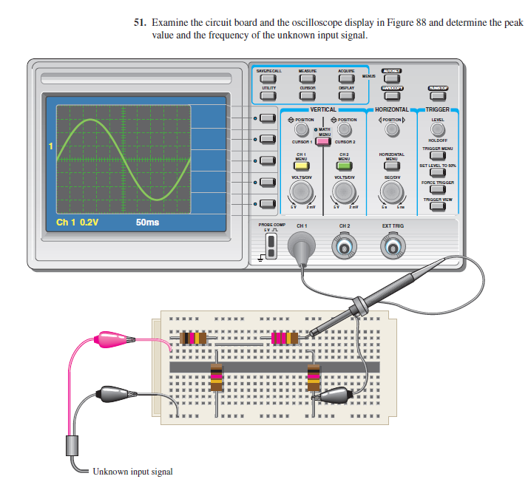
Exercises

